Slide 1

Drama At Cornwallis Academy
Year 7 – LESSON 2
Lesson Objective:
To learn what still images are and how to create them;
To understand how to use exaggerated facial expressions and levels

Slide 2
Level | Drama Strand
 | Creating | Performing | Reflecting
Entry | I can take part in a drama activity | I can participate in part of a group performance | I can identify positive and negative aspects within my work
1 | I can take part in a range of drama activities I can explore problems in an imagined world and make up plays from stories or other stimuli | I can participate in a short group performance I show some consideration of movement and voice in performance | I can make simple connections between the dramas I experience and my own life I can recognise when my own work and the work of others’, could be improved
2 | I can perform my own simple scenes, demonstrating an understanding of drama techniques | I can use my voice and body to create a simple character I can act out improvised dramas | I can talk about why I made certain decisions in my play I can show a basic understanding of how meaning can be shown
3 | I can establish a character with control over movement and voice I can use the dialogue in existing texts as well as creating my own I can devise plays from a range of stimuli I can respond to the use of drama techniques to deepen the role or understanding of the situation e.g. hot seating I can sustain a defined character for a reasonable amount of time | I can learn lines and organise simple performances | I can give suggestions on how work could be improved I can talk about my work using some technical drama terminology I can discuss and give reasons for my preferences in the drama I have seen

Slide 3
THE CLAP
Lesson Objective:
To learn what still images are and how to create them;
To understand how to use exaggerated facial expressions and levels
What skills are you developing here?
All students stand in a circle.
As a whole class you must clap when the teacher claps.

Slide 4
Lesson Objective:
To learn what still images are and how to create them;
To understand how to use exaggerated facial expressions and levels
Key Words:
Still image – When you make a picture with your bodies that does not move or make any sound, as if a sculptor has shaped you out of stone or wood, or a painter has painted you.
Facial expression – The use of the facial movements or positioning to convey a specific emotion in the face.
Levels – Positioning in relation to another character / object in order to represent status and relationships.
WILF: Performing and Appraising
LEVEL 3: Will perform on state demonstrating what is meant by a still image, exaggerated facial expressions and levels. You will also be able to watch others work and state two things they have done well and one area for improvement.
LEVEL 4: Will perform on stage with some confidence, using still image, exaggerated facial expressions and levels. You will also be able to watch others work and describe at least two things they have done well and at least one area for improvement.
LEVEL 5: Will perform on stage with confidence, using still image, exaggerated facial expressions and levels with some skill. You will also be able to watch others work and explain many things they have done well as well as areas for further development.

Slide 5

1,2,3,4,5
Lesson Objective:
To learn what still images are and how to create them;
To understand how to use exaggerated facial expressions and levels
Students stand opposite each other in pairs and alternate the count 1, 2, 3.
A: 1
B: 2
A: 3
B:4
A:5
B:1
We will now change it up so that the Numbers are replaced with actions and words

Slide 6
ADD IN GESTURES
Lesson Objective:
To learn what still images are and how to create them;
To understand how to use exaggerated facial expressions and levels
Replace 1 with a facial expression
Replace 3 by squatting down
Replace 5 by doing a silly dance
Replace 2 by freezing
Replace 4 by making a different gesture (wave, thumbs up etc)

Slide 7
ADD WORDS TO GESTURES
Lesson Objective:
To learn what still images are and how to create them;
To understand how to use exaggerated facial expressions and levels
Replace 1 with FACIAL EXPRESSIONS and with a facial expression
Replace 3 with LEVELS and by squatting down
Replace 5 with USE OF BODY and by doing a silly dance
Replace 2 with STILLNESS and by freezing
Replace 4 with GESTURES and by making a different gesture (wave, thumbs up etc)

Slide 8
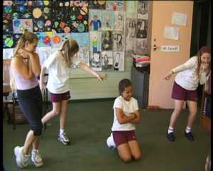
WHAT IS A STILL IMAGE?
Lesson Objective:
To learn what still images are and how to create them;
To understand how to use exaggerated facial expressions and levels
A Still Image is like a photograph, a still picture which captures an emotion or tells a story. A Still Image is where people create a scene using their bodies. The scene has to be an image made with the groups body but the image has to be still.

Slide 9
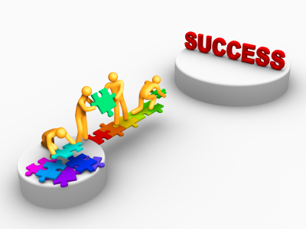
WHAT MAKES AN EFFECTIVE STILL IMAGE?
Lesson Objective:
To learn what still images are and how to create them;
To understand how to use exaggerated facial expressions and levels
Facial Expressions
Stillness
Levels
Gestures
Use of body

Slide 10
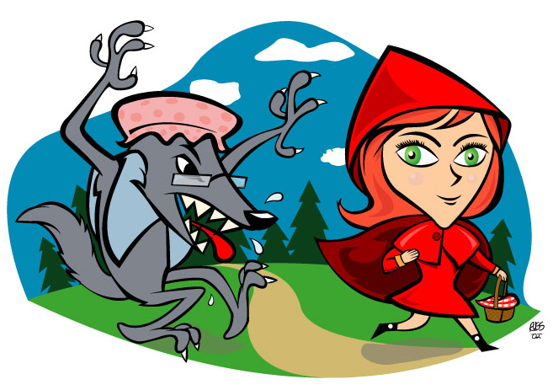
LITTLE RED RIDING HOOD
Lesson Objective:
To learn what still images are and how to create them;
To understand how to use exaggerated facial expressions and levels
In groups you must tell the story of Little Rid Riding Hood using a series of Still Images.
Discuss the story and then create a series of images to tell the story.

Slide 11
MODEL
Lesson Objective:
To learn what still images are and how to create them;
To understand how to use exaggerated facial expressions and levels
Teacher will model an effective Still Image

Slide 12
LITTLE RED RIDING HOOD
Lesson Objective:
To learn what still images are and how to create them;
To understand how to use exaggerated facial expressions and levels
Create 5-7 Still Images
Everyone must be in every Still Image
Face the audience
Remember the 5 things that make an effective image!

Slide 13
STOP AND SHOW
Lesson Objective:
To learn what still images are and how to create them;
To understand how to use exaggerated facial expressions and levels
Teacher will stop you at a random moment and check progress…
Teacher may spotlight a group…
So stay on a task!

Slide 14
Lesson Objective:
To learn what still images are and how to create them;
To understand how to use exaggerated facial expressions and levels
Presenting work and Giving positive feedback:
You will now present your still images to the rest of the class and give feedback on how successful these where. This is a vital aspect of drama and something you will be expected to do throughout your time here a Cornwallis.
What we will be looking for:
(1)Still image – Do you know what the image is of? Did they remain still? Did they face the audience and not block each other.
(2) Facial expressions – Could you understand how the characters were feeling? How/why? Where these clear and to the audience?
(3) Levels – Were levels used? How were they used? Were the relationships clear?

Slide 15
Lesson Objective:
To learn what still images are and how to create them;
To understand how to use exaggerated facial expressions and levels
Summing up:
What have you learnt today?
What level have you achieve and how/ why?
What do you need to do to meet your target grade?
Get into a pair.
Share your knowledge and ideas with your partner

